Slide 1
Graphs

Slide 2
Introduction to Graphs
Definition: A simple graph G = (V, E) consists of V, a nonempty set of vertices, and E, a set of unordered pairs of distinct elements of V called edges.
A simple graph is just like a directed graph, but with no specified direction of its edges.
Sometimes we want to model multiple connections between vertices, which is impossible using simple graphs.
In these cases, we have to use multigraphs.

Slide 3
Introduction to Graphs
Definition: A multigraph G = (V, E) consists of a set V of vertices, a set E of edges, and a function f from E to {{u, v} | u, v ∈ V, u ≠ v}.
The edges e₁ and e₂ are called multiple or parallel edges if f(e₁) = f(e₂).
Note:
Edges in multigraphs are not necessarily defined as pairs, but can be of any type.
No loops are allowed in multigraphs (u ≠ v).

Slide 4
Introduction to Graphs
Example: A multigraph G with vertices V = {a, b, c, d}, edges {1, 2, 3, 4, 5} and function f with f(1) = {a, b}, f(2) = {a, b}, f(3) = {b, c}, f(4) = {c, d} and f(5) = {c, d}:
1
4
a
b
3
c
d
2
5

Slide 5
Introduction to Graphs
If we want to define loops, we need the following type of graph:
Definition: A pseudograph G = (V, E) consists of a set V of vertices, a set E of edges, and a function f from E to {{u, v} | u, v ∈ V}.
An edge e is a loop if f(e) = {u, u} for some u∈V.
Graphs that may include loops, and possibly multiple edges connecting the same pair of vertices or a vertex to itself, are sometimes called pseudographs.

Slide 6
Introduction to Graphs
Here is a type of graph that we already know:
Definition: A directed graph G = (V, E) consists of a set V of vertices and a set E of edges that are ordered pairs of elements in V.
… leading to a new type of graph:
Definition: A directed multigraph G = (V, E) consists of a set V of vertices, a set E of edges, and a function f from E to {(u, v) | u, v ∈ V}.
The edges e₁ and e₂ are called multiple edges if f(e₁) = f(e₂).

Slide 7
Introduction to Graphs
Example: A directed multigraph G with vertices V = {a, b, c, d}, edges {1, 2, 3, 4, 5} and function f with f(1) = (a, b), f(2) = (b, a), f(3) = (c, b), f(4) = (c, d) and f(5) = (c, d):
1
4
a
b
3
c
d
2
5

Slide 8
Introduction to Graphs
Types of Graphs and Their Properties
Type
Edges
Multiple Edges?
Loops?
simple graph
undirected
no
no
multigraph
undirected
yes
no
pseudograph
undirected
yes
yes
directed graph
directed
no
yes
dir. multigraph
directed
yes
yes

Slide 9
Graph Models
Example I: How can we represent a network of (bi-directional) railways connecting a set of cities?
We should use a simple graph with an edge {a, b} indicating a direct train connection between cities a and b.
Toronto
Boston
Lübeck
New York
Hamburg
Washington

Slide 10
Graph Models
Example II: In a round-robin tournament, each team plays against each other team exactly once. How can we represent the results of the tournament (which team beats which other team)?
We should use a directed graph with an edge (a, b) indicating that team a beats team b.
Maple Leafs
Bruins
Penguins
Lübeck Giants

Slide 11
Graph Terminology
Definition: Two vertices u and v in an undirected graph G are called adjacent (or neighbors) in G if {u, v} is an edge in G.
If e = {u, v}, the edge e is called incident with the vertices u and v. The edge e is also said to connect u and v.
The vertices u and v are called endpoints of the edge {u, v}.

Slide 12
Graph Terminology
Definition: The degree of a vertex in an undirected graph is the number of edges incident with it, except that a loop at a vertex contributes twice to the degree of that vertex.
In other words, you can determine the degree of a vertex in a displayed graph by counting the lines that touch it.
The degree of the vertex v is denoted by deg(v).

Slide 13
Graph Terminology
A vertex of degree 0 is called isolated, since it is not adjacent to any vertex.
Note: A vertex with a loop at it has at least degree 2 and, by definition, is not isolated, even if it is not adjacent to any other vertex.
A vertex of degree 1 is called pendant. It is adjacent to exactly one other vertex.

Slide 14
Graph Terminology
Example: Which vertices in the following graph are isolated, which are pendant, and what is the maximum degree? What type of graph is it?
i
h
d
a
e
g
b
c
f
j
Solution: Vertex f is isolated, and vertices a, d and j are pendant. The maximum degree is deg(g) = 5. This graph is a pseudograph (undirected, loops).

Slide 15
Graph Terminology
Let us look at the same graph again and determine the number of its edges and the sum of the degrees of all its vertices:
i
h
d
a
e
g
b
c
f
j
Result: There are 9 edges, and the sum of all degrees is 18. This is easy to explain: Each new edge increases the sum of degrees by exactly two.

Slide 16
Graph Terminology
The Handshaking Theorem: Let G = (V, E) be an undirected graph with e edges. Then
2e = ∑_{v∈V} deg(v)
Note: This theorem holds even if multiple edges and/or loops are present.
Example: How many edges are there in a graph with 10 vertices, each of degree 6?
Solution: The sum of the degrees of the vertices is 6⋅10 = 60. According to the Handshaking Theorem, it follows that 2e = 60, so there are 30 edges.

Slide 17
Graph Terminology
Theorem: An undirected graph has an even number of vertices of odd degree.
Idea: There are three possibilities for adding an edge to connect two vertices in the graph:
Before: After:
Both vertices have even degree
Both vertices have odd degree
Both vertices have odd degree
Both vertices have even degree
One vertex has odd degree, the other even
One vertex has even degree, the other odd

Slide 18
Graph Terminology
There are two possibilities for adding a loop to a vertex in the graph:
Before: After:
The vertex has even degree
The vertex has even degree
The vertex has odd degree
The vertex has odd degree

Slide 19
Graph Terminology
So if there is an even number of vertices of odd degree in the graph, it will still be even after adding an edge.
Therefore, since an undirected graph with no edges has an even number of vertices with odd degree (zero), the same must be true for any undirected graph.
Please also study the proof on
4th Edition: page 446
5th Edition: page 547
6th edition: page 599

Slide 20
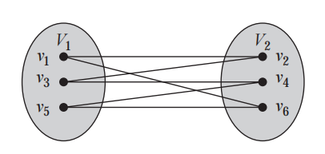
Baipartite Graph
A simple graph G is called bipartite if its vertex set V can be partitioned into two disjoint sets V1 and V2 such that every edge in the graph connects a vertex in V1 and a vertex in V2 (so that no edge in G connects either two vertices in V1 or two vertices in V2). When this condition holds, we call the pair (V1, V2) a bipartition of the vertex set V of G.

Slide 21
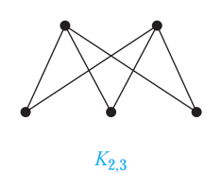
Complete bipartite graph
A complete bipartite graph Km,n is a graph that has its vertex set partitioned into two subsets of m and n vertices, respectively with an edge between two vertices if and only if one vertex is in the first subset and the other vertex is in the second subset.

Slide 22
Graph-Path-Circuit
Other Types of Graphs:
Multigraphs
Directed Graphs
Directed Multigraphs
Paths and Circuits:
Basic Definitions
Euler Paths and Circuits
Hamilton Paths and Circuits

Slide 23
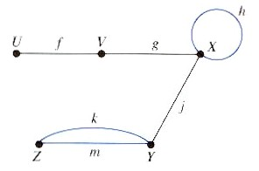
12.1. Multigraphs
A multigraph G = (V, E):
Is a graph where we allow
A loop, i.e. an edge to join a vertex to itself and
Several edges joining the same pair of vertices.
Such a graph is also called undirected multigraph.
Examples:

Slide 24
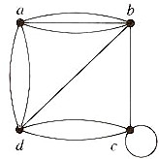
12.1. Multigraphs
Examples (continued):
Adjacency matrix of a multigraph:
deg(a) = 5
deg(4) = 4

Slide 25
12.2. Directed Graphs
A directed graph G = (V, E):
Is a graph where an edge represents a one-way relation only.
Cf. undirected graph – an edge represents two-way or symmetric relationship between two vertices.
The number of directed edges which initiate from vertex v is called the outdegree of v or outdeg(v).
The number of directed edges which terminate at vertex v is called the indegree of v or indeg(v).

Slide 26
12.2. Directed Graphs
Theorem:

Slide 27
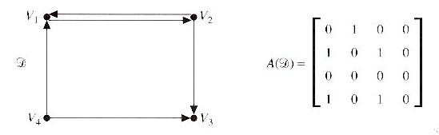
12.2. Directed Graphs
Examples (continued):
Adjacency matrix of a directed graph:
outdeg(V₁) = 1, indeg(V₁) = 2
outdeg(V₃) = 0, indeg(V₃) = 2
outdeg(V₄) = 2, indeg(V₄) = 0
Notes:
Sum of rows give us outdegree.
Sum of columns give us indegree.

Slide 28
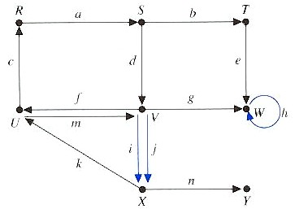
12.3. Directed Multigraphs
A directed multigraph G = (V, E):
Is a directed graph where we allow
A directed loop, i.e. a directed edge from a vertex to itself and
Several parallel directed edges from a vertex to another.
Examples:

Slide 29
12.4. Paths and Circuits
A u-v walk from u to v:
Is an alternating sequence of vertices and edges
V₁, e₁, V₂, e₂, V₃, e₃, …, V_{n}, e_{n}, V_{n+1}
where
the first vertex V₁ is u and
the last vertex V_{n+1} is v and
the edge e_{i} joins V_{i} and V_{i+1} for i = 1, 2, …, n.
The length of this walk is n.
A walk provides a way of describing how to go from one vertex to another by following edges.
The vertices and the edges may be repeated.
a path is a sequence of edges that begins at a vertex of a graph and travels from
vertex to vertex along edges of the graph. As the path travels along its edges, it visits the vertices along this path, that is, the endpoints of t
Notes:
May not be the most efficient route.
Simple path is an efficient route between vertices.
The path or cirucit is said to pass through or traverse the vertices V1, V2, … Vn.

Slide 30
12.4. Paths and Circuits
A u-v path:
Is a walk from u to v in which no vertex, and hence, no edge is repeated.
A circuit:
Is an walk that begins and ends at the same vertex, i.e. if u = v, and no edge is repeated.
When there is no chance of confusion, a path can be represented by:
The vertices V₁, V₂, V₃, …, V_{n}, V_{n+1} only or
The edges e₁, e₂, e₃, …, e_{n} only.

Slide 31
12.4. Paths and Circuits
Examples:
U, f, V, g, X or f, g is a path of length 2 from U to X.
f, g, h is a walk of length 3 from U to X.
U, V, Z, Y is not a path since { V, Z } is not an edge.
U, f, V, f, U is a walk of length 2 from U to U.
Z,k,Y,m,Z is a circuit of length 2

Slide 32
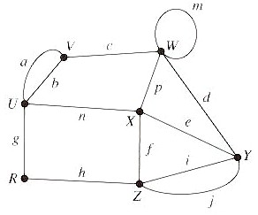
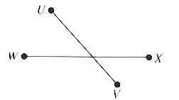
12.4. Paths and Circuits
Connected:
A graph is called connected if there is a path between every pair of vertices.
Examples:
Connected
Not connected
Notes:
Graph G is connected since a path can be found between any two vertices.
Graph H is not connected since there is no path from vertex U to vertex W.

Slide 33
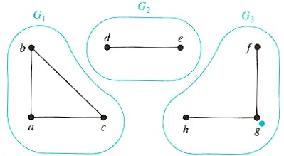
12.4. Paths and Circuits
(Connected) components of a graph G:Are the maximally connected subgraphs of G.
Examples:
Graph G is not connected since it is a union of three disjoint connected subgraphs G₁, G₂, and G₃.
G₁, G₂, and G₃ are the components of graph G.

Slide 34
12.5. Euler Paths and Circuits
An Euler path in graph G:
Is a path that includes exactly once all the edges of G.
An Euler circuit in graph G:
Likewise, but with same starting and ending vertices
Notes:
Two conditions – connected and degree of each vertex is even.
Application – in testing a communication network. It is often necessary to examine each link in the system. In order to minimize the cost of such a test, it is desirable to device a route that goes through each edge exactly once.

Slide 35
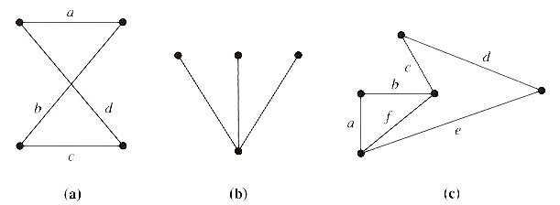
12.5. Euler Paths and Circuits
Examples:
The path a, b, c, d in (a) is an Euler circuit since all edges are included exactly once.
The graph (b) has neither an Euler path nor circuit.
The graph (c) has an Euler path a, b, c, d, e, f but not an Euler circuit.
Notes:
To include all three of the edges in the path, we would have to backtrack and use an edge twice.

Slide 36

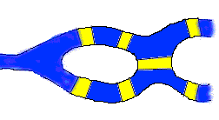
12.5. Euler Paths and Circuits
Historical note
In Europe: Konigsberg 7-bridge problem
Konigsberg, originally in Prussia, now in Russia
Four sections, two rivers, seven bridges
Euler solved this problem in 1736; the origin of graph theory
Notes:
To include all three of the edges in the path, we would have to backtrack and use an edge twice.

Slide 37
12.5. Euler Paths and Circuits
Problem: Draw a path (or circuit) with a pencil in such a way that you trace over each bridge once and only once and you complete the 'plan' with one continuous pencil stroke

Slide 38
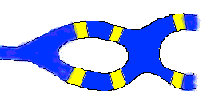
12.5. Problem Variations
Problem 2 Suppose they had decided to build one fewer bridge in Konigsberg, so that the map looked like this:
Problem 3 Does it matter which bridge you take away? What if you add bridges? Come up with some maps on your own, and try to 'plan your journey' for each one

Slide 39
12.5. Euler Paths and Circuits
Problem: Draw a path (or circuit) with a pencil in such a way that you trace over each bridge once and only once and you complete the 'plan' with one continuous pencil stroke

Slide 40
12.5. Euler Circuits
Theorem:
A connected multigraph has an Euler circuit if and only if the degree of each vertex is even.
Why ?
A graph is called planar if it can be drawn in the plane without any edges crossing (where a crossing of edges is the intersection of the lines or arcs representing them at a point other than their common endpoint). Such a drawing is called a planar representation of the graph.
Notes:
Two conditions – connected and degree of each vertex is even.
Application – in testing a communication network. It is often necessary to examine each link in the system. In order to minimize the cost of such a test, it is desirable to device a route that goes through each edge exactly once.

Slide 41
12.5. Euler Circuits
Theorem:
A connected multigraph has an Euler circuit if and only if the degree of each vertex is even.
Proof (Basic idea) :
For each vertex, if there is one “in”, there must be one “out”, because this is a circuit.
Notes:
Two conditions – connected and degree of each vertex is even.
Application – in testing a communication network. It is often necessary to examine each link in the system. In order to minimize the cost of such a test, it is desirable to device a route that goes through each edge exactly once.

Slide 42
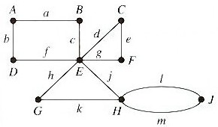
12.5. Euler Circuits
Examples:
Construct an Euler circuit for the following graph.
Solution:
The graph is connected and the degree of each vertex is even. So, it has an Euler circuit.

Slide 43
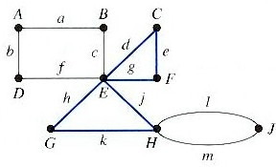
12.5. Euler Circuits
Procedure for constructing an Euler circuit:
Select any vertex u, and construct a path P₁ from u to u by randomly selecting unused edges for as long as possible.
e.g. if we start at G, we may construct the path:
P₁: G, h, E, d, C, e, F, g, E, j, H, k, G
Notes:
Such a path must return to the starting vertex because the degree of each vertex is even and the number of vertices is finite.

Slide 44
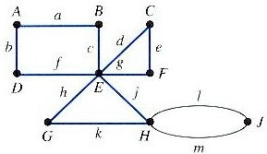
12.5. Euler Circuits
Procedure (continued):
Since the multigraph is connected, there must be a vertex in P₁ that is incident with an edge not in P₁.
In this case, the vertices E and H are such vertices.
Arbitrarily choose one of these, say E, and construct a path P₂ from E to E.
P₂: E, c, B, a, A, b, D, f, E

Slide 45
12.5. Euler Circuits
Procedure (continued):
Enlarge P₁ to include the path P₂ by replacing any one occurrence of E in P₁ by P₂.
e.g. replace the first occurrence of E in P1:
P₁: G, h, E, c, B, a, A, b, D, f, E, d,
C, e, F, g, E, j, H, k, G
Repeat the above process.
Construct a path P₃ from H to H and enlarge P₁ by P₃, we obtain the Euler circuit.
P₁: G, h, E, c, B, a, A, b, D, f, E, d,
C, e, F, g, E, j, H, m, J, l, H, k, G

Slide 46
12.5. Euler Paths
Theorem:
A connected multigraph has an Euler path but not an Euler circuit if an only if it has exactly two vertices of odd degree.
Why ?
Notes:
Two conditions – connected and degree of each vertex is even.
Application – in testing a communication network. It is often necessary to examine each link in the system. In order to minimize the cost of such a test, it is desirable to device a route that goes through each edge exactly once.

Slide 47
12.5. Euler Paths
Theorem:
A connected multigraph has an Euler path but not an Euler circuit if an only if it has exactly two vertices of odd degree.
Proof:
If: add one edge connects the two vertices of odd degree
Notes:
Two conditions – connected and degree of each vertex is even.
Application – in testing a communication network. It is often necessary to examine each link in the system. In order to minimize the cost of such a test, it is desirable to device a route that goes through each edge exactly once.

Slide 48
12.5. Euler Paths/Circle in Complete Graphs
K2
K6
K2: Euler path – ?
Euler cycle – ?
K3: Euler path – ?
Euler cycle – ?
K4: Euler path – ?
Euler cycle – ?
K5: Euler path – ?
Euler cycle – ?
K6: Euler path – ?
Euler cycle – ?
K8: Euler path – ?
Euler cycle – ?
K3
K8
K4
K5
Notes:
Two conditions – connected and degree of each vertex is even.
Application – in testing a communication network. It is often necessary to examine each link in the system. In order to minimize the cost of such a test, it is desirable to device a route that goes through each edge exactly once.

Slide 49
12.5. Euler Paths/Circle in Complete Graphs
K2
K6
K2: Euler path – Yes
Euler cycle – No
K3: Euler path – No
Euler cycle – Yes
K4: Euler path – No
Euler cycle – No
K5: Euler path – No
Euler cycle – Yes
K6: Euler path – No
Euler cycle – No
K8: Euler path – No
Euler cycle – No
K3
K8
K4
K5
Notes:
Two conditions – connected and degree of each vertex is even.
Application – in testing a communication network. It is often necessary to examine each link in the system. In order to minimize the cost of such a test, it is desirable to device a route that goes through each edge exactly once.

Slide 50
12.6. Hamilton Paths and Circuits
A Hamilton path in graph G:
Is a path that includes each vertex once and only once.
Notes:
Since we want ot avoid repetition of vertices, loops and parallel edges will not be of any assistance. Consequently, we may assume that we are working with a graph.

Slide 51
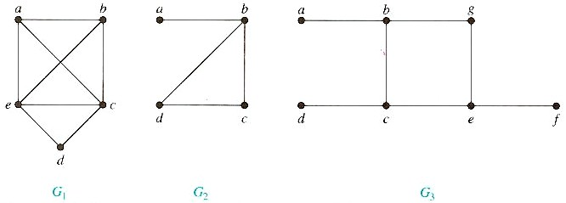
12.6. Hamilton Paths and Circuits
Examples:
G₁ has a Hamilton path: a, b, c, d, e.
G₂ has only a Hamilton path: a, b, c, d.
G₃ has no.
In general, no efficient method to find such a path
Notes:
G2 has not circuit, because to cotain every vertex, it must contain edge {a, b} twice.
G3 has not since any path containing all vertices must contain one of the edges {a, b}. {e, f} and {c, d} more than once.

Slide 52
Isomorphism of Graphs
From a visual standpoint, G₁ and G₂ are isomorphic if they can be arranged in such a way that their displays are identical (of course without changing adjacency).
Unfortunately, for two simple graphs, each with n vertices, there are n! possible isomorphisms that we have to check in order to show that these graphs are isomorphic.
However, showing that two graphs are not isomorphic can be easy.

Slide 53
Isomorphism of Graphs
For this purpose we can check invariants, that is, properties that two isomorphic simple graphs must both have.
For example, they must have
the same number of vertices,
the same number of edges, and
the same degrees of vertices.
Note that two graphs that differ in any of these invariants are not isomorphic, but two graphs that match in all of them are not necessarily isomorphic.

Slide 54
Isomorphism of Graphs
Example I: Are the following two graphs isomorphic?
a
a
b
e
e
b
c
d
c
d
Solution: Yes, they are isomorphic, because they can be arranged to look identical. You can see this if in the right graph you move vertex b to the left of the edge {a, c}. Then the isomorphism f from the left to the right graph is: f(a) = e, f(b) = a, f(c) = b, f(d) = c, f(e) = d.

Slide 55
Isomorphism of Graphs
Example II: How about these two graphs?
a
a
b
e
e
b
c
c
d
d
Solution: No, they are not isomorphic, because they differ in the degrees of their vertices.
Vertex d in right graph is of degree one, but there is no such vertex in the left graph.

Slide 56
Connectivity
Definition: A path of length n from u to v, where n is a positive integer, in an undirected graph is a sequence of edges e₁, e₂, …, e_{n} of the graph such that f(e₁) = {x₀, x₁}, f(e₂) = {x₁, x₂}, …, f(e_{n}) = {x_{n-1}, x_{n}}, where x₀ = u and x_{n} = v.
When the graph is simple, we denote this path by its vertex sequence x₀, x₁, …, x_{n}, since it uniquely determines the path.
The path is a circuit if it begins and ends at the same vertex, that is, if u = v.

Slide 57
Connectivity
Definition (continued): The path or circuit is said to pass through or traverse x₁, x₂, …, x_{n-1}.
A path or circuit is simple if it does not contain the same edge more than once.

Slide 58
Connectivity
Definition: A path of length n from u to v, where n is a positive integer, in a directed multigraph is a sequence of edges e₁, e₂, …, e_{n} of the graph such that f(e₁) = (x₀, x₁), f(e₂) = (x₁, x₂), …, f(e_{n}) = (x_{n-1}, x_{n}), where x₀ = u and x_{n} = v.
When there are no multiple edges in the path, we denote this path by its vertex sequence x₀, x₁, …, x_{n}, since it uniquely determines the path.
The path is a circuit if it begins and ends at the same vertex, that is, if u = v.
A path or circuit is called simple if it does not contain the same edge more than once.

Slide 59
Connectivity
Let us now look at something new:
Definition: An undirected graph is called connected if there is a path between every pair of distinct vertices in the graph.
For example, any two computers in a network can communicate if and only if the graph of this network is connected.
Note: A graph consisting of only one vertex is always connected, because it does not contain any pair of distinct vertices.

Slide 60
Connectivity
Example: Are the following graphs connected?
a
b
a
b
e
e
d
d
c
c
Yes.
No.
a
b
a
b
e
e
d
c
d
f
c
Yes.
No.

Slide 61
Connectivity
Theorem: There is a simple path between every pair of distinct vertices of a connected undirected graph.
See page 469 (4th Edition), 570 (5th Edition), or 625 (6th Edition) in the textbook for the proof.
Definition: A graph that is not connected is the union of two or more connected subgraphs, each pair of which has no vertex in common. These disjoint connected subgraphs are called the connected components of the graph.

Slide 62
Connectivity
Example: What are the connected components in the following graph?
i
h
d
a
e
g
b
c
f
j
Solution: The connected components are the graphs with vertices {a, b, c, d}, {e}, {f}, {i, g, h, j}.

Slide 63
Connectivity
Definition: A directed graph is strongly connected if there is a path from a to b and from b to a whenever a and b are vertices in the graph.
Definition: A directed graph is weakly connected if there is a path between any two vertices in the underlying undirected graph.

Slide 64
Connectivity
Example: Are the following directed graphs strongly or weakly connected?
a
Weakly connected, because, for example, there is no path from b to d.
b
d
c
a
Strongly connected, because there are paths between all possible pairs of vertices.
b
d
c

Slide 65
Connectivity
Idea: The number and size of connected components and circuits are further invariants with respect to isomorphism of simple graphs.
Example: Are these two graphs isomorphic?
Solution: No, because the right graph contains circuits of length 3, while the left graph does not.

Slide 66
Shortest Path Problems
We can assign weights to the edges of graphs, for example to represent the distance between cities in a railway network:
Toronto
650
700
Boston
Chicago
200
600
New York

Slide 67
Shortest Path Problems
Such weighted graphs can also be used to model computer networks with response times or costs as weights.
One of the most interesting questions that we can investigate with such graphs is:
What is the shortest path between two vertices in the graph, that is, the path with the minimal sum of weights along the way?
This corresponds to the shortest train connection or the fastest connection in a computer network.

Slide 68
Dijkstra’s Algorithm
Dijkstra’s algorithm is an iterative procedure that finds the shortest path between to vertices a and z in a weighted graph.
It proceeds by finding the length of the shortest path from a to successive vertices and adding these vertices to a distinguished set of vertices S.
The algorithm terminates once it reaches the vertex z.

Slide 69
Dijkstra’s Algorithm
procedure Dijkstra(G: weighted connected simple graph with vertices a = v₀, v₁, …, v_{n} = z and positive weights w(v_{i}, v_{j}), where w(v_{i}, v_{j}) = ∞ if {v_{i}, v_{j}} is not an edge in G)
for i := 1 to n
L(v_{i}) := ∞
L(a) := 0
S := ∅
{the labels are now initialized so that the label of a is zero and all other labels are ∞, and the distinguished set of vertices S is empty}

Slide 70
Dijkstra’s Algorithm
while z∉S
begin
u := the vertex not in S with minimal L(u)
S := S∪{u}
for all vertices v not in S
if L(u) + w(u, v) < L(v) then L(v) := L(u) + w(u, v)
{this adds a vertex to S with minimal label and updates the labels of vertices not in S}
end {L(z) = length of shortest path from a to z}

Slide 71
Dijkstra’s Algorithm
Example:
b
∞
d
∞
5
4
6
a
1
8
z
2
0
3
∞
2
10
c
∞
e
∞
Step 0

Slide 72
Dijkstra’s Algorithm
Example:
b
∞
4 (a)
d
∞
5
4
6
a
1
8
z
2
0
3
∞
2
10
c
∞
2 (a)
e
∞
Step 1

Slide 73
Dijkstra’s Algorithm
Example:
b
∞
4 (a)
3 (a, c)
d
∞
10 (a, c)
5
4
6
a
1
8
z
2
0
3
∞
2
10
c
∞
2 (a)
e
∞
12 (a, c)
Step 2

Slide 74
Dijkstra’s Algorithm
Example:
b
∞
4 (a)
3 (a, c)
d
∞
10 (a, c)
8 (a, c, b)
5
4
6
a
1
8
z
2
0
3
∞
2
10
c
∞
2 (a)
e
∞
12 (a, c)
Step 3

Slide 75
Dijkstra’s Algorithm
Example:
b
∞
4 (a)
3 (a, c)
d
∞
10 (a, c)
8 (a, c, b)
5
4
6
a
1
8
z
2
0
3
∞
14 (a, c, b, d)
2
10
c
∞
2 (a)
e
∞
12 (a, c)
10 (a, c, b, d)
Step 4

Slide 76
Dijkstra’s Algorithm
Example:
b
∞
4 (a)
3 (a, c)
d
∞
10 (a, c)
8 (a, c, b)
5
4
6
a
1
8
z
2
0
3
∞
14 (a, c, b, d)
13 (a, c, b, d, e)
2
10
c
∞
2 (a)
e
∞
12 (a, c)
10 (a, c, b, d)
Step 5

Slide 77
Dijkstra’s Algorithm
Example:
b
∞
4 (a)
3 (a, c)
d
∞
10 (a, c)
8 (a, c, b)
5
4
6
a
1
8
z
2
0
3
∞
14 (a, c, b, d)
13 (a, c, b, d, e)
2
10
c
∞
2 (a)
e
∞
12 (a, c)
10 (a, c, b, d)
Step 6

Slide 78
Dijkstra’s Algorithm
Theorem: Dijkstra’s algorithm finds the length of a shortest path between two vertices in a connected simple undirected weighted graph.
Theorem: Dijkstra’s algorithm uses O(n²) operations (additions and comparisons) to find the length of the shortest path between two vertices in a connected simple undirected weighted graph.
Please take a look at pages 492 to 496 (4th Edition), 595 to 599 (5th Edition), or 649 to 653 (6th Edition) for a comprehensive description and analysis of Dijkstra’s algorithm.

Slide 79
Graph Coloring
These class notes are based on material from our textbook, Discrete Mathematics and Its Applications, by Kenneth H. Rosen, published by McGraw Hill, Boston. They are intended for classroom use only and are not a substitute for reading the textbook.

Slide 80
Introduction
When a map is colored, two regions with a common border are customarily assigned different colors.
We want to use the smallest number of colors instead of just assigning every region its own color.
A coloring of a simple graph is the assignment of a color to each vertex of the graph so that
no two adjacent vertices are assigned the same color.

Slide 81
4-Color Map Theorem
It can be shown that any two-dimensional map can be painted using four colors in such a way that adjacent regions (meaning those which sharing a common boundary segment, and not just a point) are different colors.

Slide 82
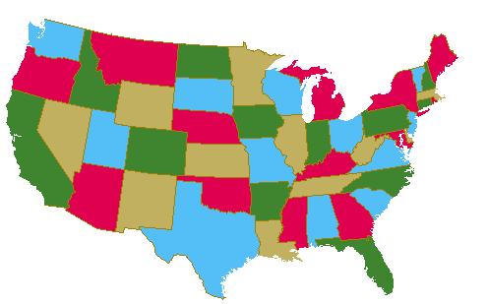
Map Coloring
Four colors are sufficient to color a map of the contiguous United States.
Source of map: http://www.math.gatech.edu/~thomas/FC/fourcolor.html

Slide 83
Dual Graph
Each map in a plane can be represented by a graph.
Each region is represented by a vertex.
Edges connect to vertices if the regions represented by these vertices have a common border.
Two regions that touch at only one point are not considered adjacent.
The resulting graph is called the dual graph of the map.

Slide 84
Dual Graph Examples
B
B
G
A
C
D
A
F
C
D
E
E
b
a d f g
e
b
a e
d
c
c

Slide 85
Graph Coloring
A coloring of a simple graph is the assignment of a color to each vertex of the graph so that no two adjacent vertices are assigned the same color.
The chromatic number of a graph is the least number of colors needed for a coloring of the graph.

Slide 86
The Four Color Theorem
The chromatic number of a planar graph is no greater than four.
It was originally posed as a conjecture in the 1850s.
It was finally proved by two American mathematicians
Kenneth Apple and Wolfgang Haken in 1976.
This is the first mathematical theorem
that has been proven with help of computers.
They showed that if the theorem is false, there must be a counterexample
of one of approximately 2000 types.
They used computers to show that none of these counterexamples exists.

Slide 87
Example
What is the chromatic number of the graph shown below?
The chromatic number must be at least 3 since a, b, and c must be assigned different colors. So Let’s try 3 colors first. 3 colors work, so the chromatic number of this graph is 3.
b e
a d g
c f

Slide 88
Example
What is the chromatic number for each of the following graphs?
White
White
Yellow
Green
Yellow
Yellow
White
White
Yellow
Yellow
White
Chromatic number: 2 Chromatic number: 3

Slide 89
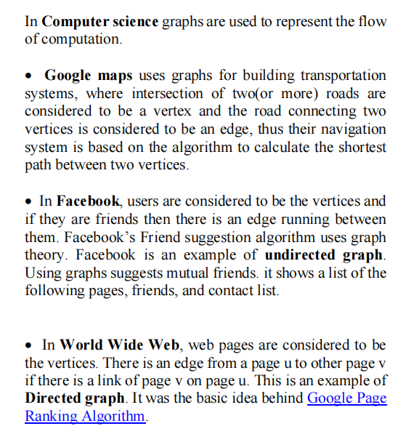
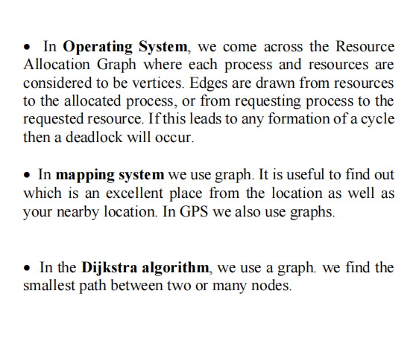
Graph Application

